Slide 1
C++ with Cevelop
Typedef

Slide 2

What is Typedef?
Renaming a datatype or a container
Very useful if your data type and container is a lot for you to type and is reusable

Slide 3
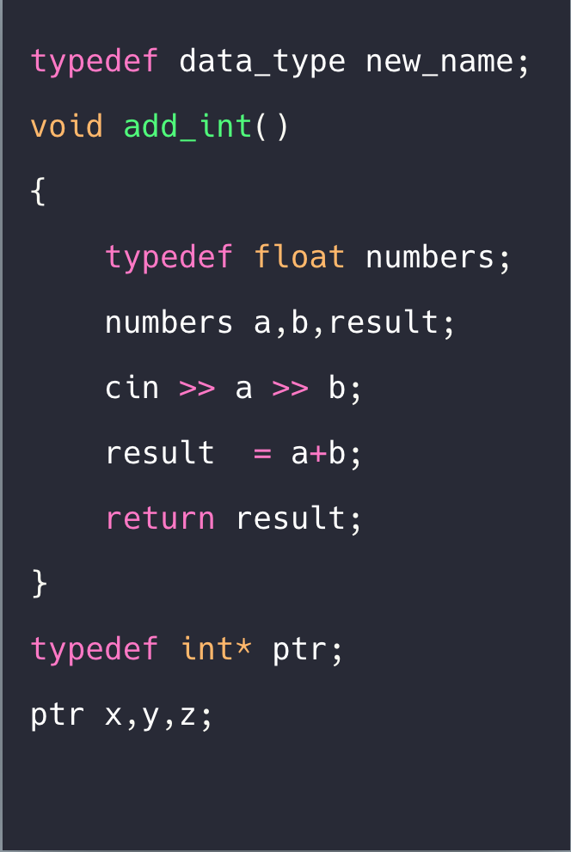
How Do You Implement Typedef?
typedef [data type(int, double, etc..) or container(Vector, etc.)] [name you want to give this data type or container]

